Slide 1


The potential of BERT-based language models for the extraction of Indicators of Compromise from Cyber Threat Intelligence reports​
MSc in Cyber Risk Strategy and Governance - October 2023
Jacopo Grassi

Slide 2





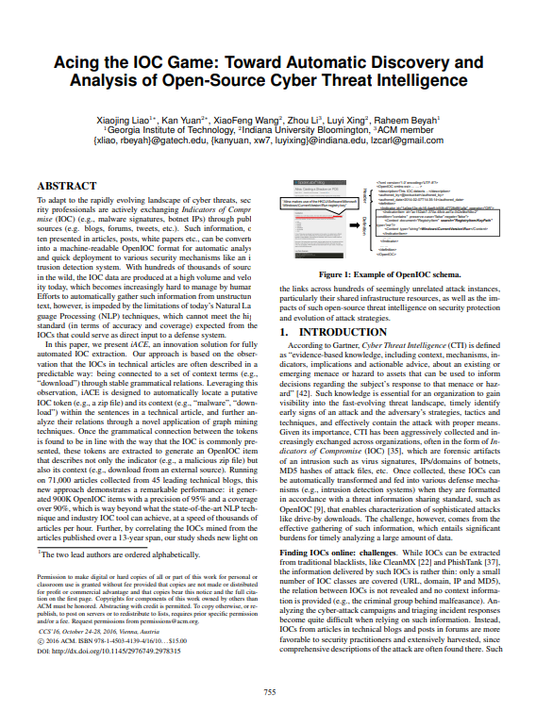

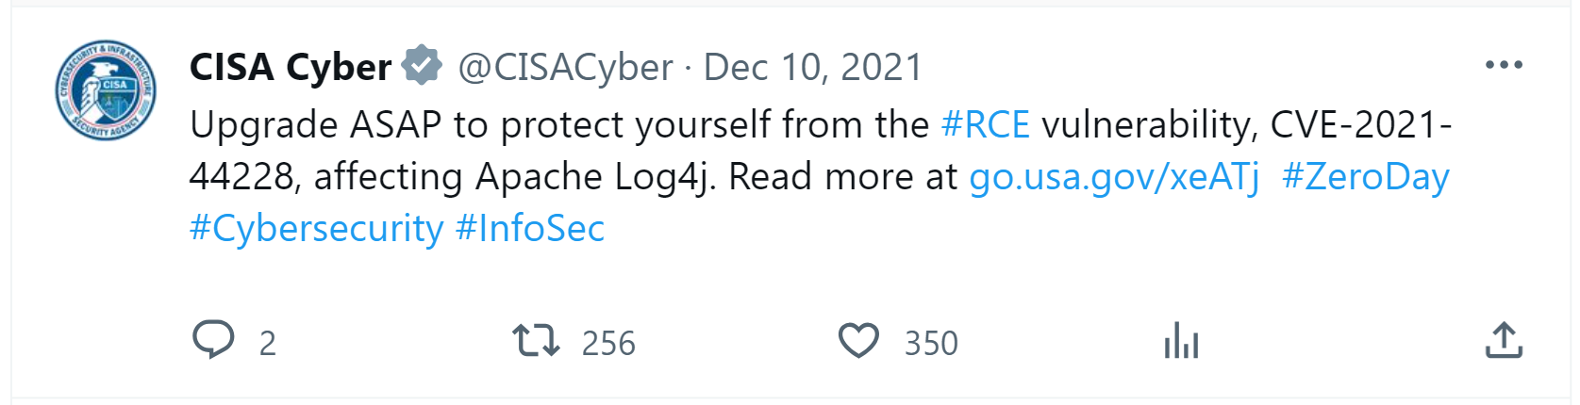
Cyber Threat Intelligence - IoC
Background and Motivations
An Indicator of Compromise (IoC) is an artifact observed on a network or computer system indicating (with an acceptable level of confidence) the occurrence of an intrusion or attack.
Atomic Indicators
Computed Indicators
Behavioral Indicators (Tactics, Techniques, Procedures)
Information Overload
Intelligence Consumption
Identification of Cyber Threat
Forensic Activities
Intelligence Dissemination
Blacklists Institutional reports
Academic papers
Scientific articles
Blogs posts Social Network posts
Etc.
Natural Language Text
1 / 12

Slide 3


Cyber Threat Intelligence - IoC
Background and Motivations
An Indicator of Compromise (IoC) is an artifact observed on a network or computer system indicating (with an acceptable level of confidence) the occurrence of an intrusion or attack.
Atomic Indicators
Computed Indicators
Behavioral Indicators (Tactics, Techniques, Procedures)
We need automation!
Identification of Cyber Threat
Forensic Activities
Intelligence Dissemination
Blacklists Institutional reports
Academic papers
Scientific articles
Blogs posts Social Network posts
Etc.
Natural Language Text
1 / 12

Slide 4
Challenges of automatic IoC extraction
Background and Motivations
Automatic extraction of IoC from natural language text can be challenging…
Regular Expressions (Regex) are not enough.
“An Internet Protocol address is a numerical label such as 192.0.2.1”
Categorizing entities is not enough.
“The following analysis is based on the ABC trojan sample with SHA-1 7c9c8ee87d5d7fd95e4c1ec8559632fdaec09ad2.”
2 / 12

Slide 5
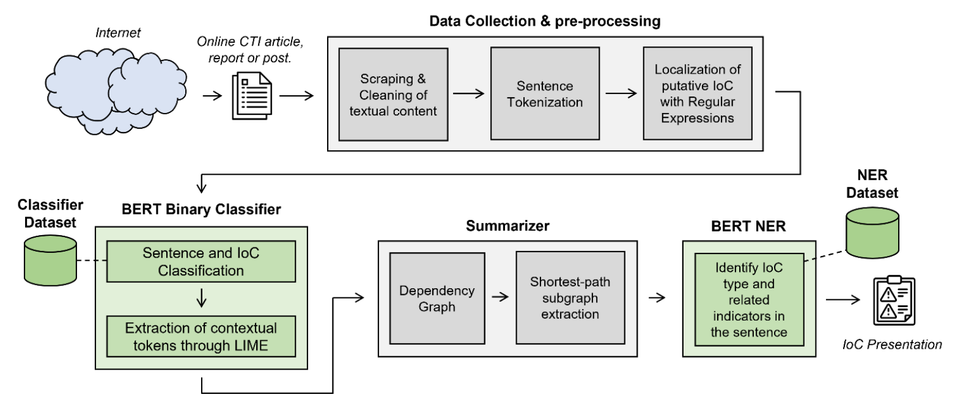
Pipeline
Proposed Approach
3 / 12

Slide 6
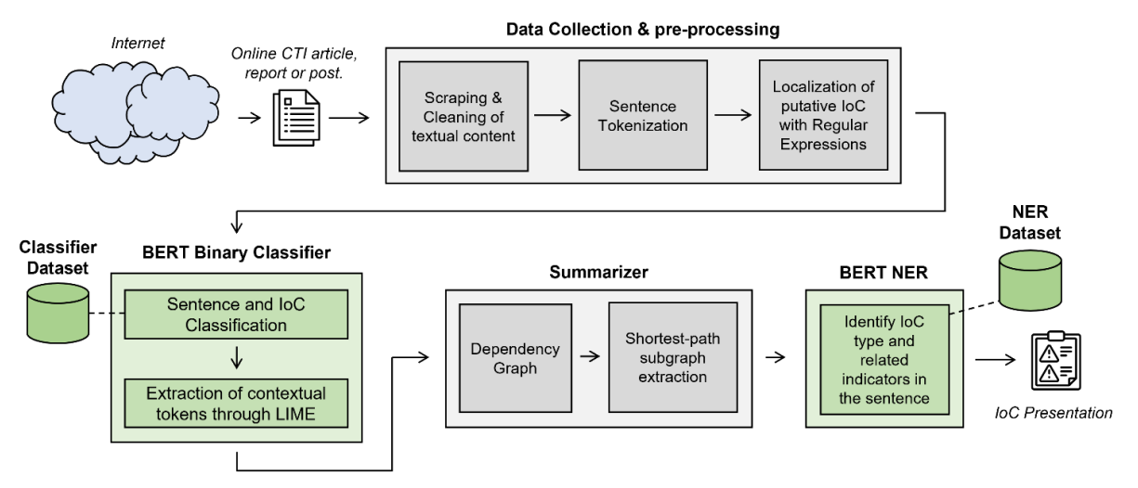
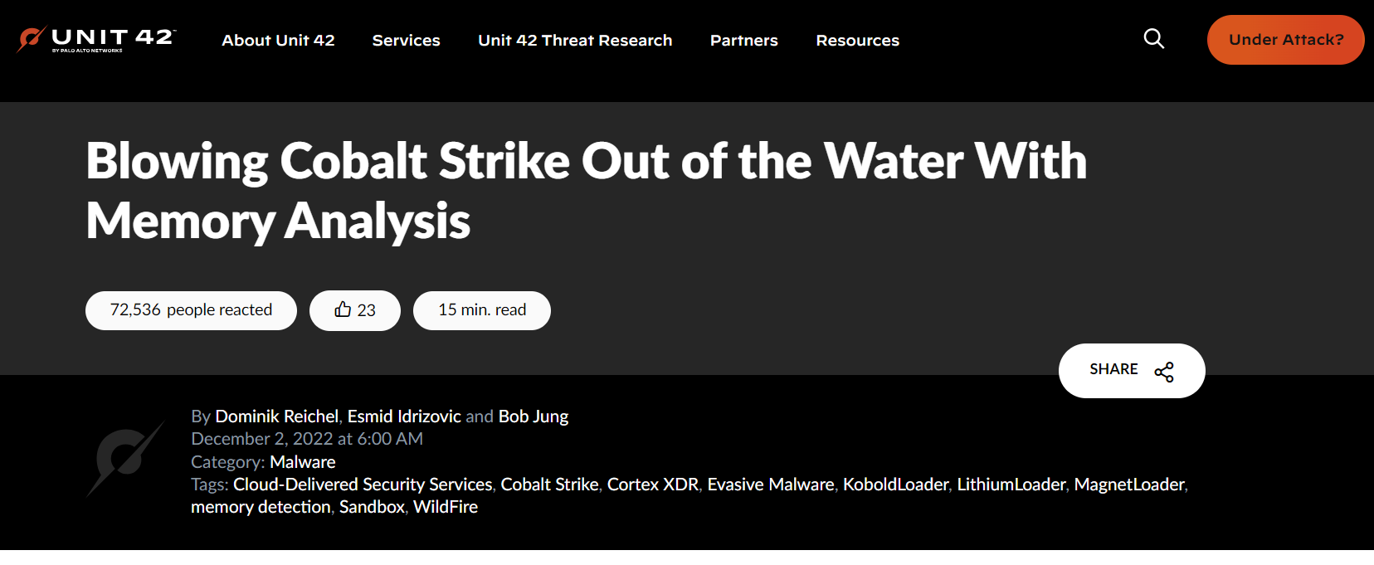
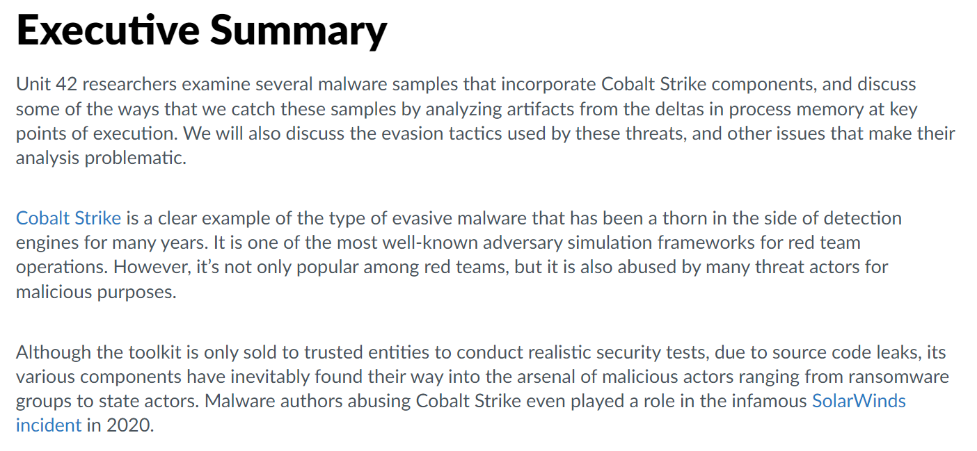

Data collection and pre-processing
Proposed Approach
REGEX Categories
<p>To do this, the malware first loads the <span style="font-family: 'Courier New', Courier, monospace">pla.dll</span> library and zeroes out a chunk of bytes inside its code section. It then writes the beacon file into this blob and fixes the import address table, thus creating an executable memory module.</p>
To do this, the malware first loads the pla.dll library and zeroes out a chunk of bytes inside its code section.
It then writes the beacon file into this blob and fixes the import address table, thus creating an executable memory module.
Cleaning of textual content
Remove code sections (e.g. <pre> or <code>)
Remove special symbols (e.g. emojis)
Unsanitize text (e.g. malicious[.]com)
BeautifulSoup
PyPDF2
Etc.
4 / 12

Slide 7

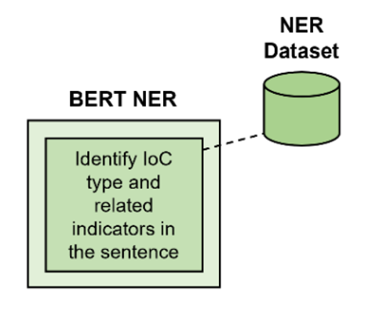
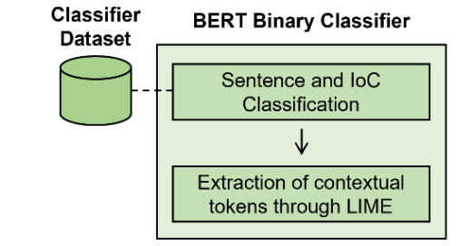
BERT (Bidirectional Encoder Representations from Transformers)
Proposed Approach
Introduced by Google researchers in 2018, BERT is a deep learning language model based on the Transformer Encoder architecture. We treat it like a Black Box system.
The model has been pre-trained on a massive corpus of unlabeled text.
We use it for Binary Text Classification and Named Entity Recognition.
5 / 12

Slide 8
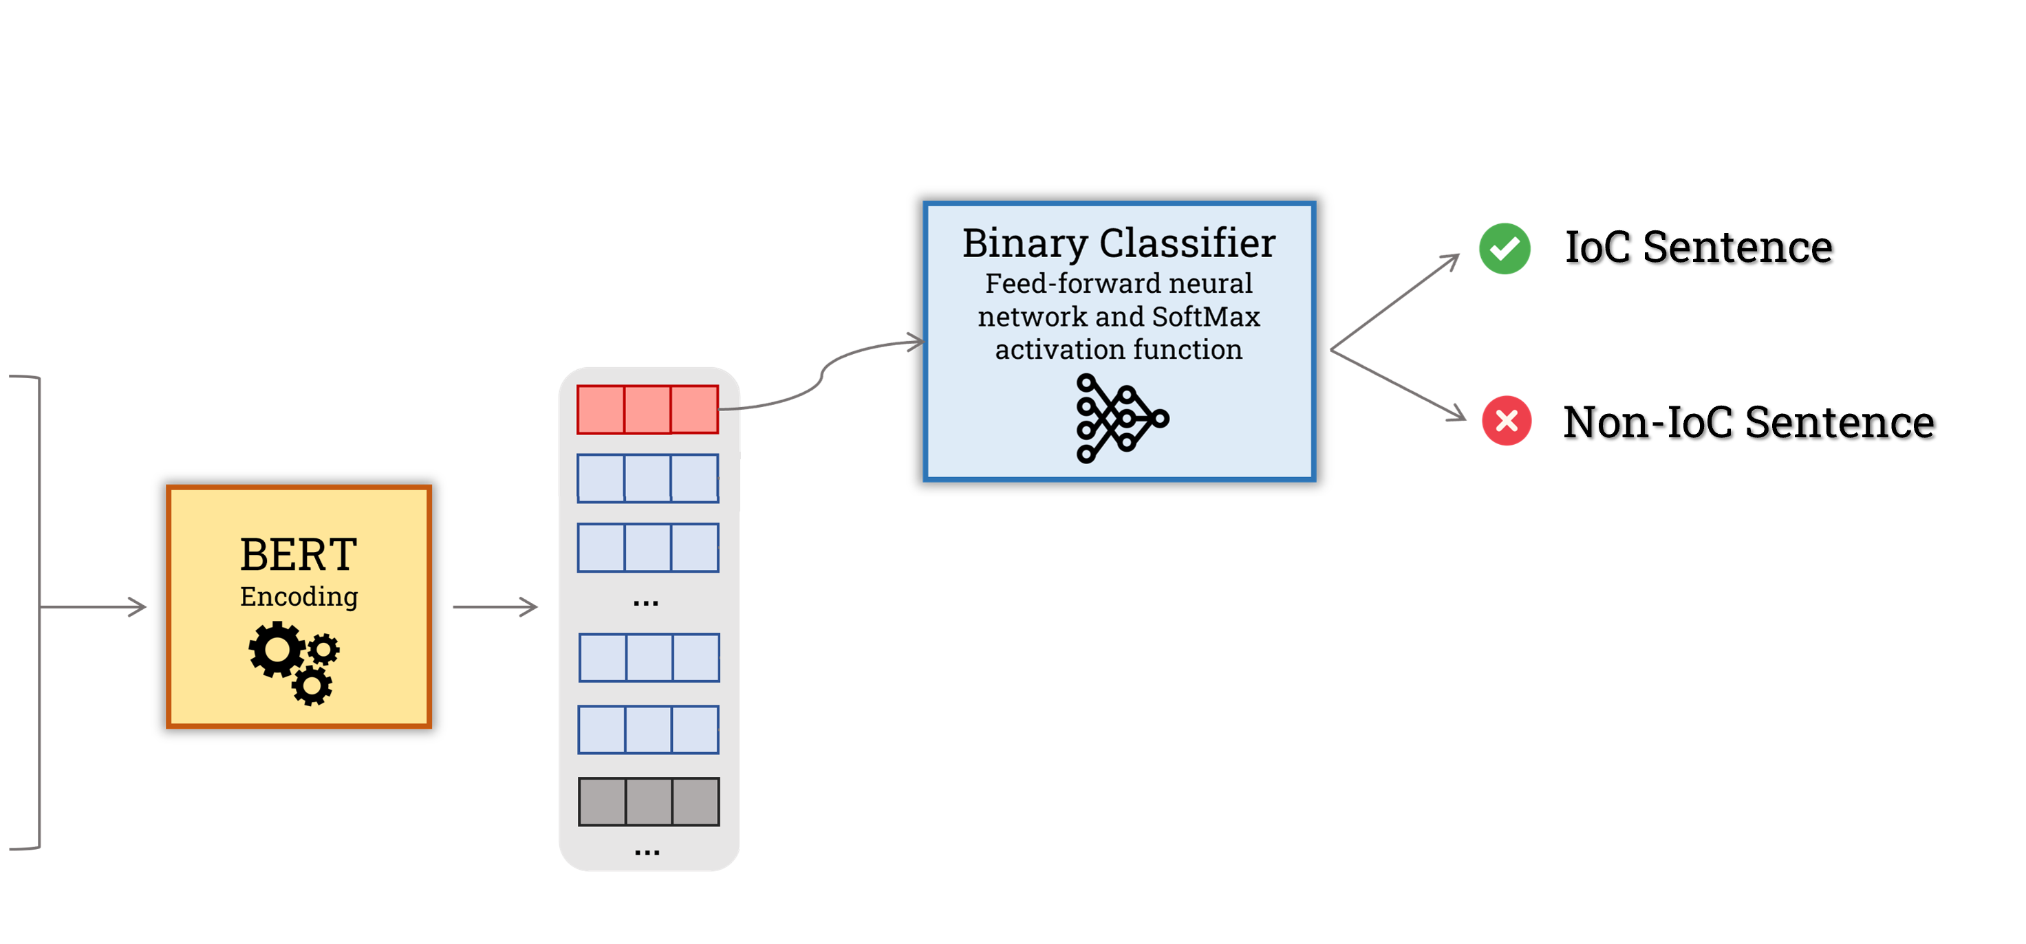

Binary Text Classifier – Fine-tuning
Proposed Approach
Pre-trained and ready-to-use
To do this, the malware first loads the pla.dll library and zeroes out a chunk of bytes inside its code section.
Contextual Representations
[CLS]
To
do
… …
[IOC]
370 online scraped CTI reports/articles
1700 manually labeled putative IoC sentences
70% true-IoC sentences
pla.dll
[IOC]
… …
[SEP]
[PAD]
HuggingFace Transformers
PyTorch
Numpy, Pandas, etc.
6 / 12

Slide 9
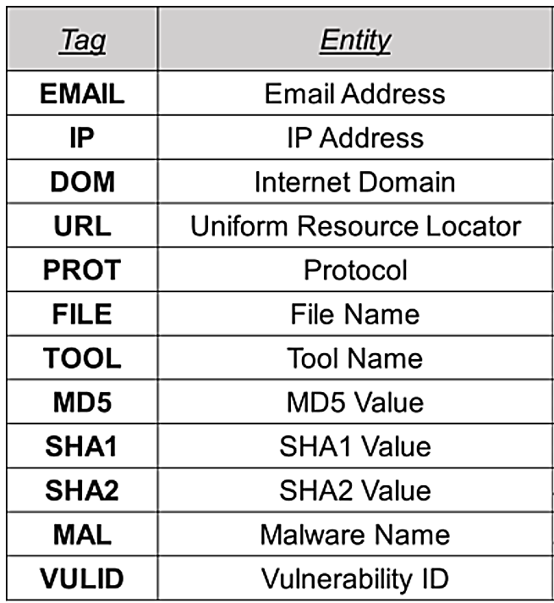
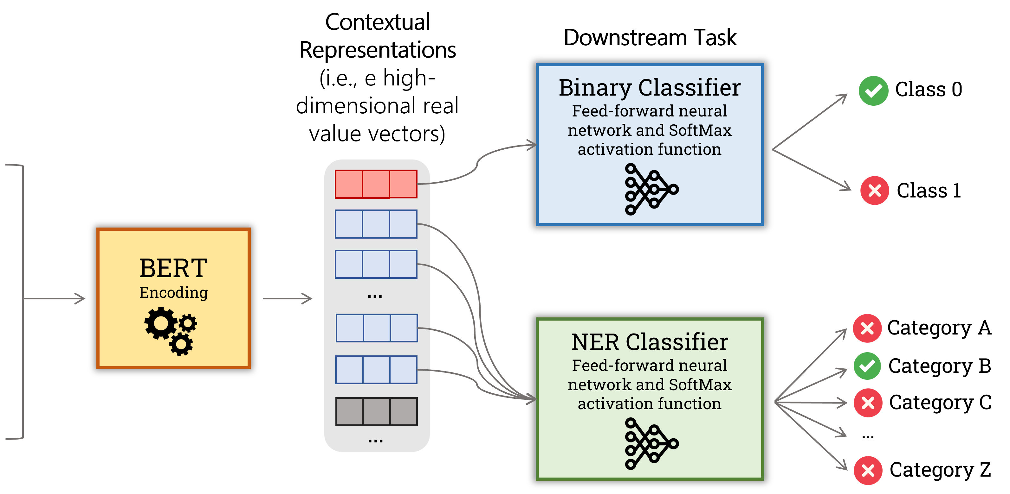
NER Classifier – Fine-tuning
Proposed Approach
Modified OSINT “APTNER” Dataset
11.000 pre-labeled sentences, comprising the following IoC categories:
Pre-trained and ready-to-use
To do this, the malware first loads the pla.dll library and zeroes out a chunk of bytes inside its code section.
Contextual Representations
[CLS]
To
do
… …
[IOC]
pla.dll
Email Address
[IOC]
… …
File Name
HuggingFace Transformers
PyTorch
Numpy, Pandas, etc.
[SEP]
URL
[PAD]
Vuln. Identifier
7 / 12

Slide 10
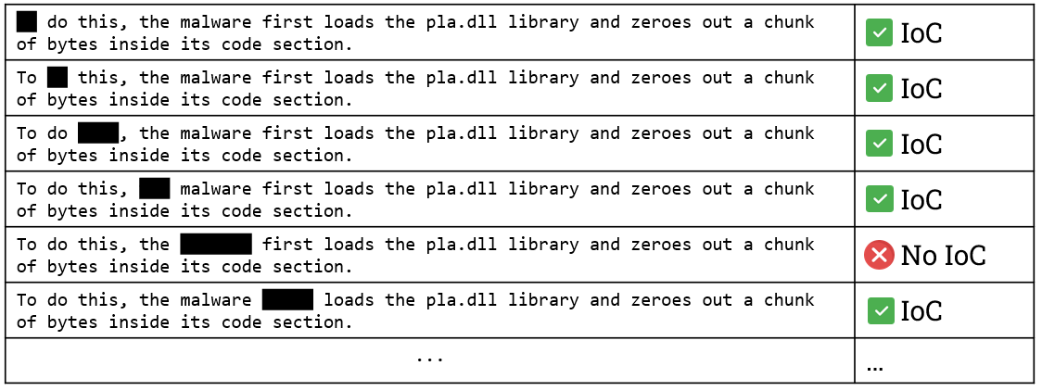
Contextual Terms extraction – LIME (Local Interpretable Model-agnostic Explanations)
Proposed Approach
Context Terms = Words that contribute significantly to classifying a sentence as “IoC Sentence”.
To do this, the malware first loads the pla.dll library and zeroes out a chunk of bytes inside its code section.
Prediction of BERT-based Text Classifier
8 / 12

Slide 11
Contextual Terms extraction – LIME (Local Interpretable Model-agnostic Explanations)
Proposed Approach
Context Terms = Words that contribute significantly to classifying a sentence as “IoC Sentence”.
To do this, the malware first loads the pla.dll library and zeroes out a chunk of bytes inside its code section.
8 / 12

Slide 12
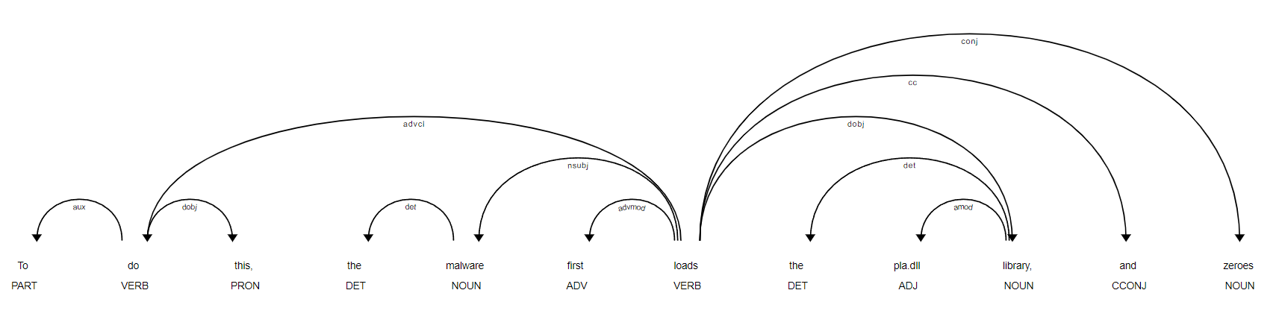
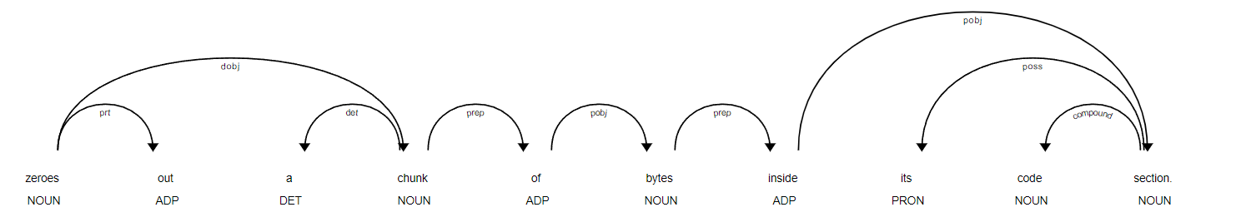
Rudimental automatic summarizer
Proposed Approach
“ malware loads pla.dll library zeroes chunk of bytes ”
Natural Language Toolkit (NLTK)
MIT Spacy
9 / 12

Slide 13
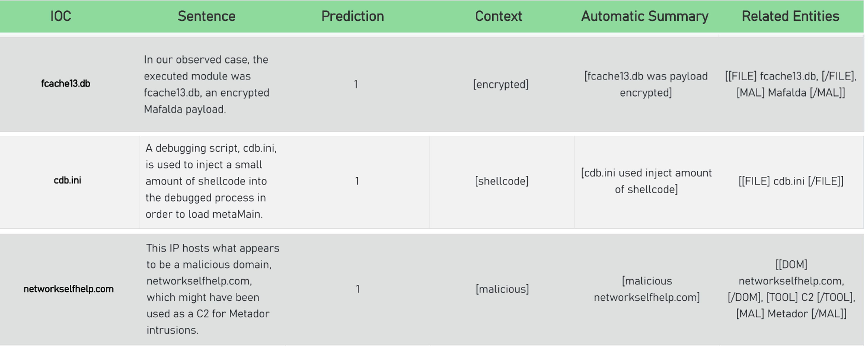
Field-Testing
Realistic Scenario
Regex Approach
10 / 12

Slide 14
Field-Testing
Realistic Scenario
BERT-based Binary Classifier
Regex Approach
10 / 12

Slide 15
Field-Testing
Realistic Scenario
BERT-based Binary Classifier
LIME + Dependency Parsing
Regex Approach
10 / 12

Slide 16
Field-Testing
Realistic Scenario
BERT-based Binary Classifier
LIME + Dependency Parsing
BERT-based NER
Regex Approach
10 / 12

Slide 17
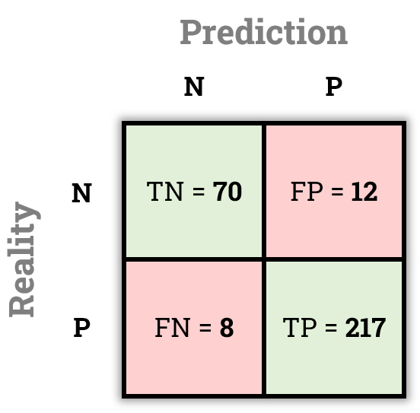
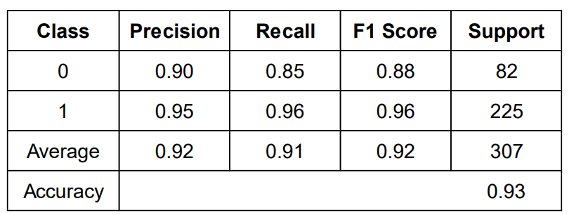
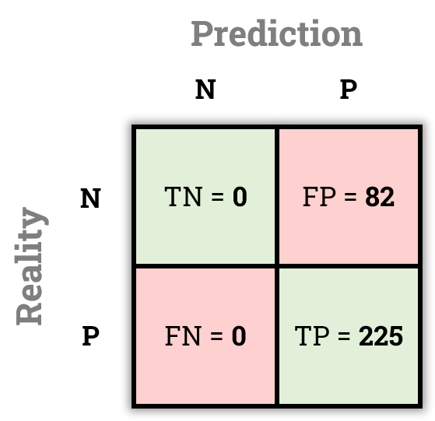
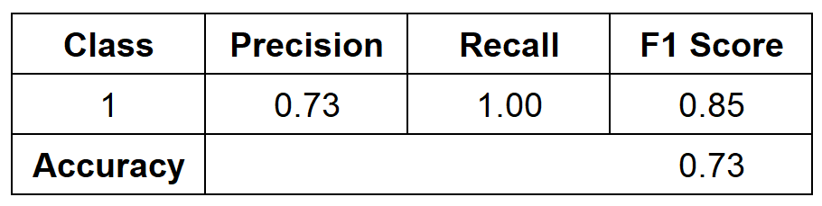
Binary Text Classifier – Testing and evaluation metrics
Proposed Approach
+22%
+20%
Regex Only
11 / 12

Slide 18
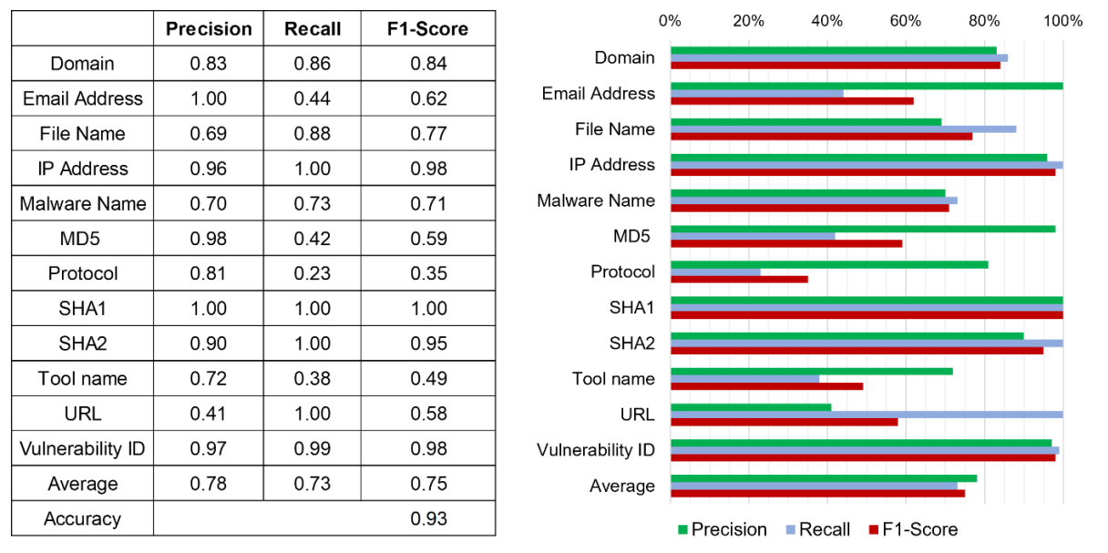
NER Classifier – Testing and evaluation metrics
Proposed Approach
Few incorrectly tagged, but missed many.
We can expect many false positives
Missed none, but incorrectly tagged many.
12 / 12

Slide 19
THANK YOU

Slide 20
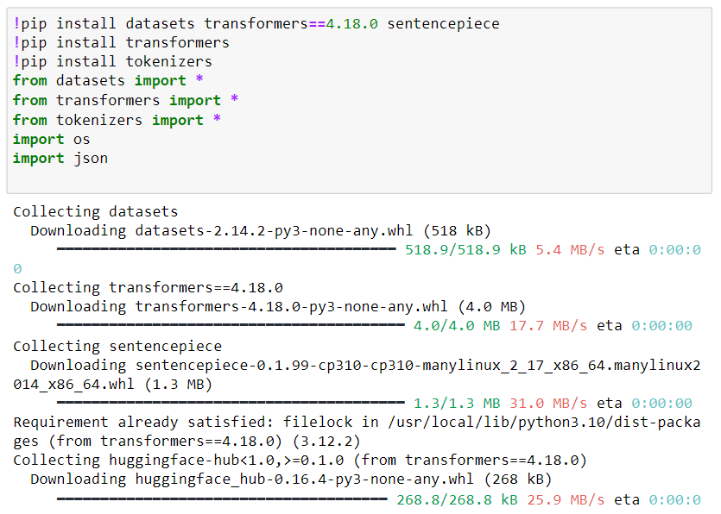
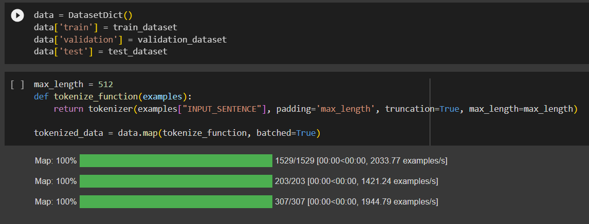
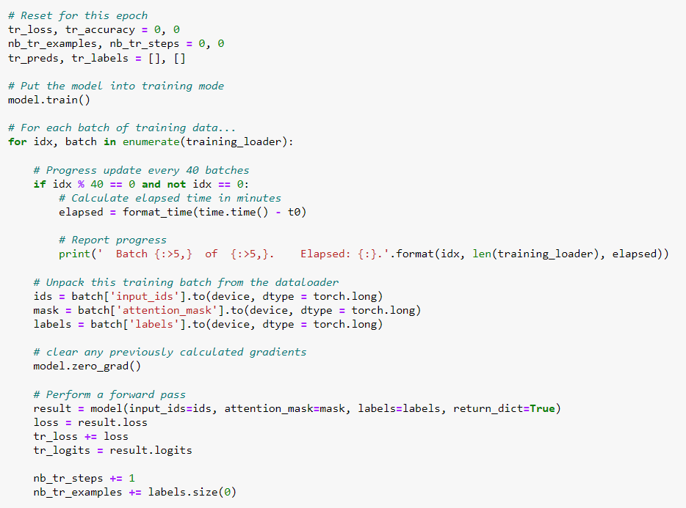
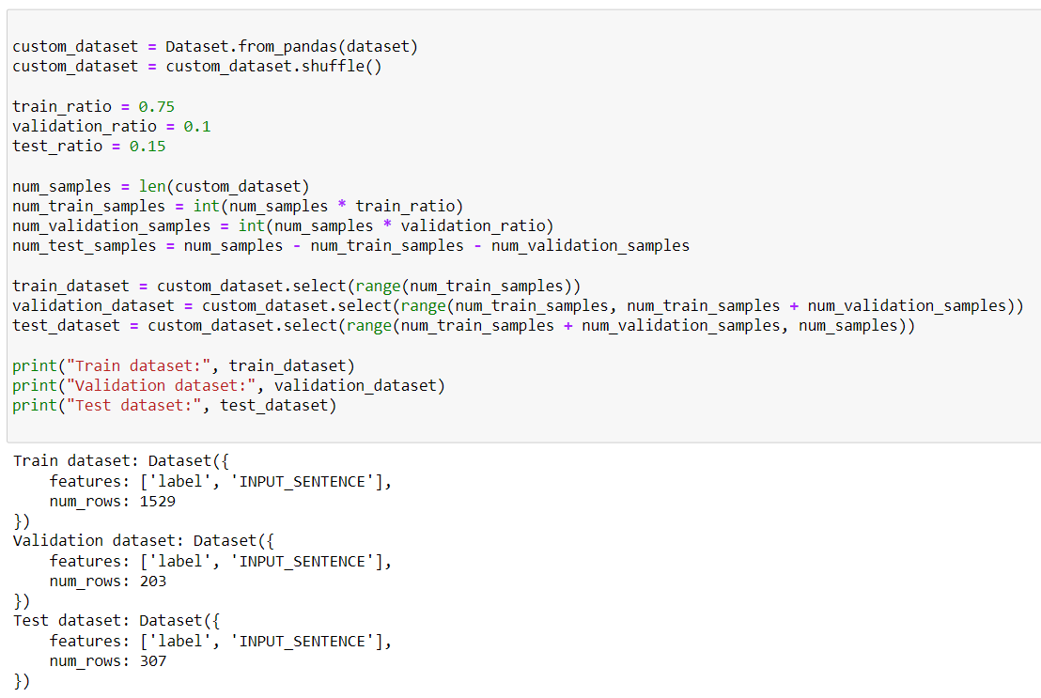
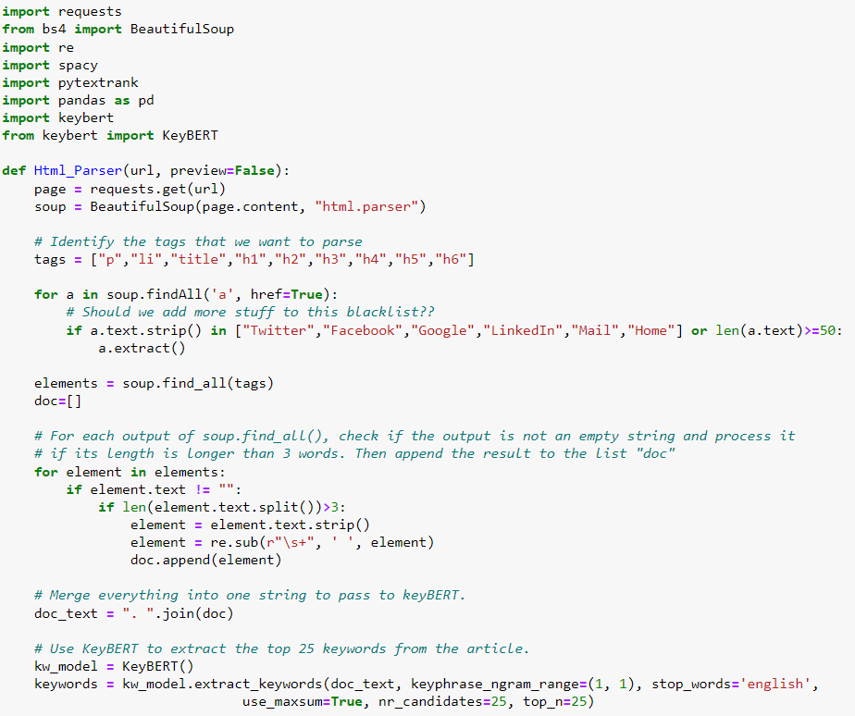
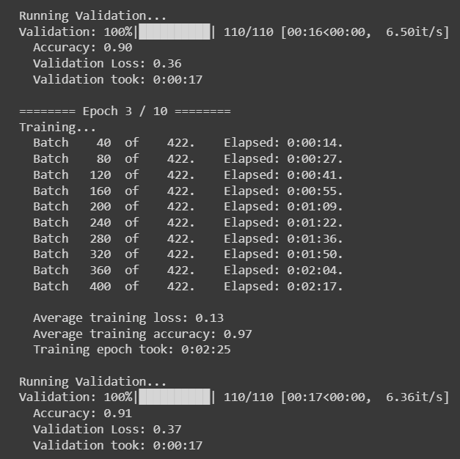
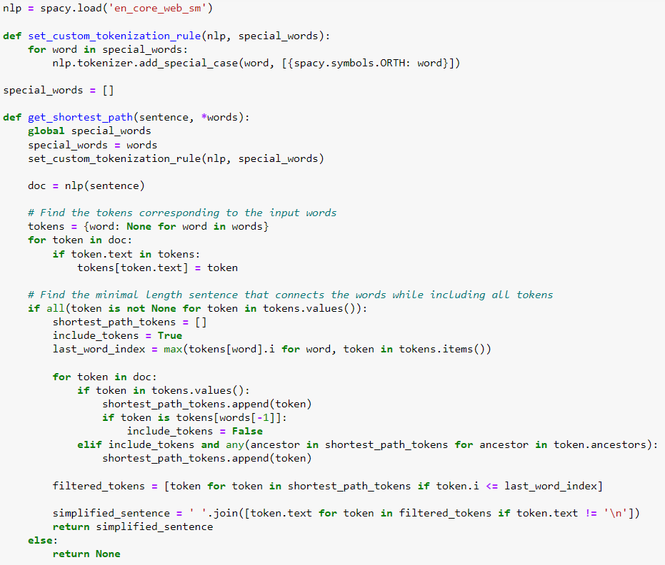
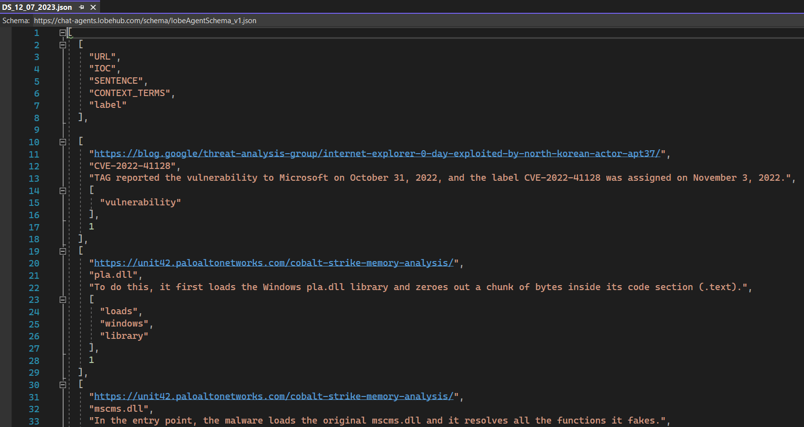
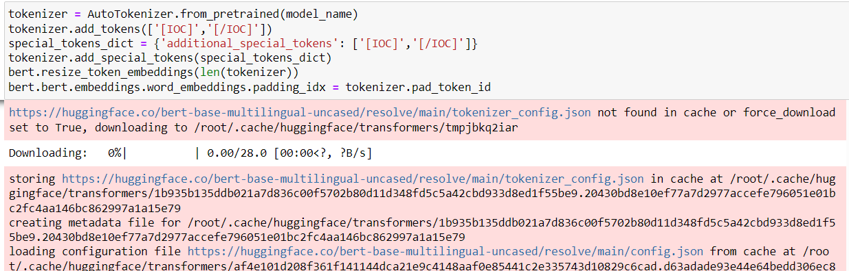
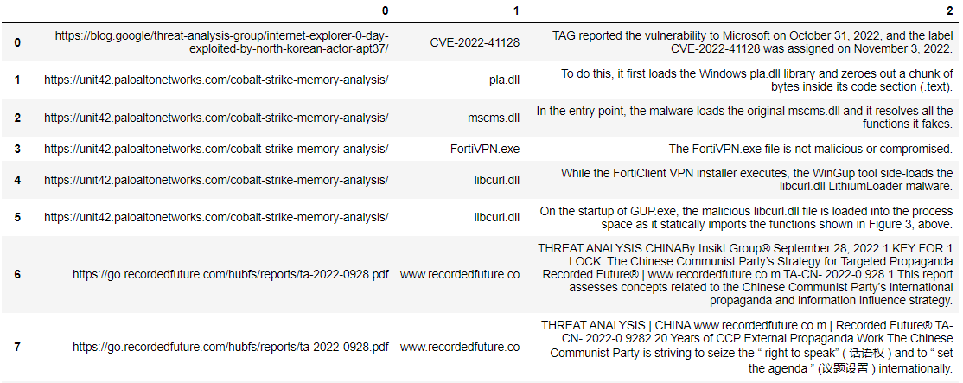
And thanks to Tommaso Paladini for reviewing my code
and helping out with the implementation.

Slide 21
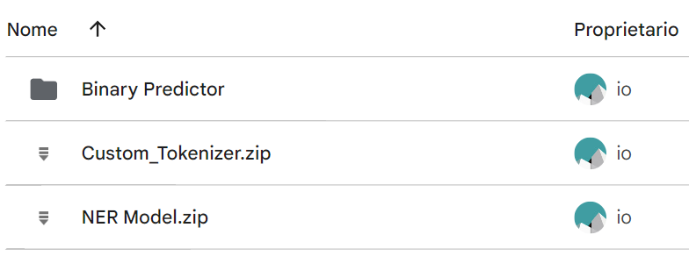
The models are available

Slide 22
Back-up

Slide 23
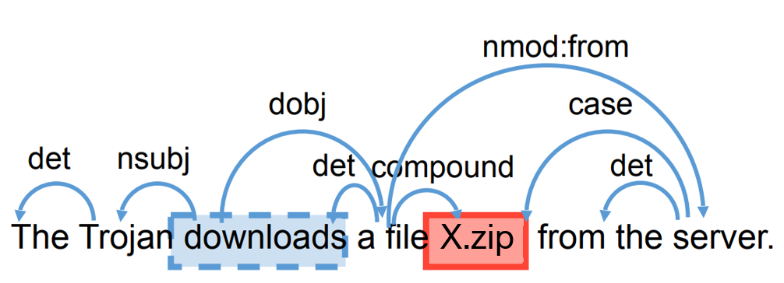
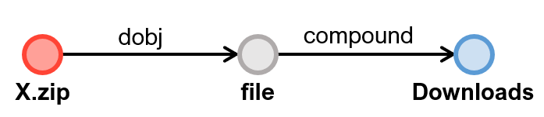
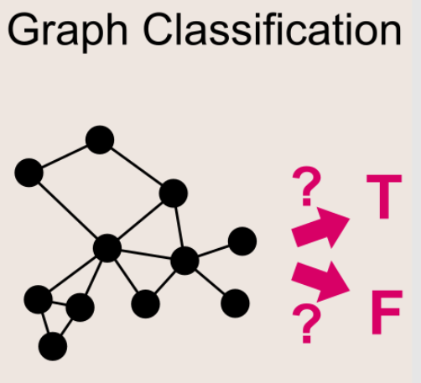
Previous approaches and related work
Backup
To locate contextual terms in the sentence, X. Liao et al. suggested the following approach:
“technical articles and posts tend to describe IOCs in a simple and straightforward manner, using a fixed set of context terms.”
…
“Further, the grammatical connections between such terms and their corresponding IOCs are also quite stable”
But what about…
long and complex sentences?
informal language?
anomalous punctuations?
weird formats?
uncommon context terms?

Slide 24
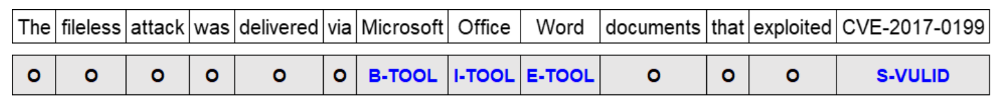
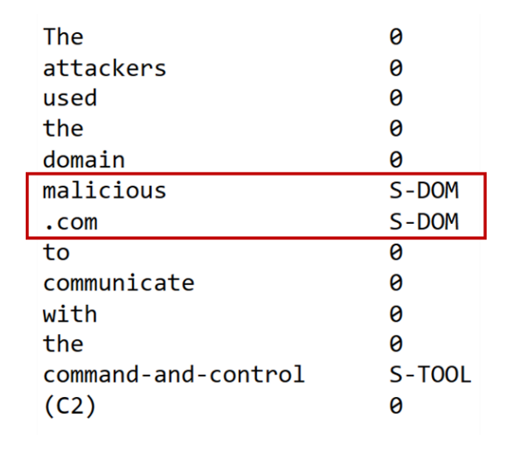
Named Entity Recognition
Backup
The following is the annotation scheme used in the APTNER dataset. The NER Classifier outputs will have the same structure.
Adding a NER layer is useful for three reasons:
categorize the IoC extracted through REGEX
find other IoC
spotting IoC that cannot be found by REGEX

Slide 25
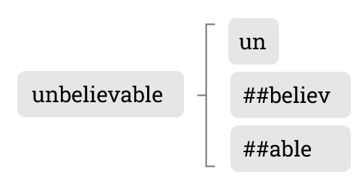
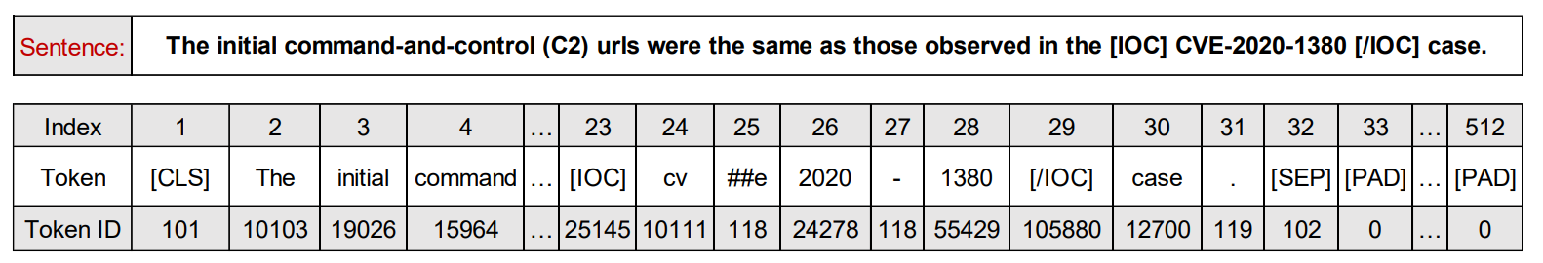
Tokenization
Backup
BERT utilizes a purposefully designed and pre-trained model for tokenizing sentences: WordPiece.
Working with sub-words is useful to:
limit the dictionary size
manage out-of-dictionary words
better capture semantic meaning

Slide 26
Limitations and Future Works
Backup
Limitations
Future works
Quality and Quantity of Training Data
Manual validation and periodical retraining of BERT-based models (feed-back loop mechanism)
Model’s behavior is static
Not enough context in a single sentence
Processing longer texts
The extraction of CTI could be further automated
Crawling
Web-based dashboard
GUI for faster validation
SIEM integration

Slide 27
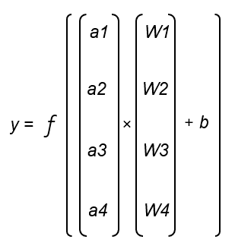
FFNN - Forward propagation
Backup
a1
W1
ŷ
a2
W2
b
f
ŷ
W3
a3
W4
a4
a
+
ŷ =
×
W
b
Loss = y - ŷ

Slide 28
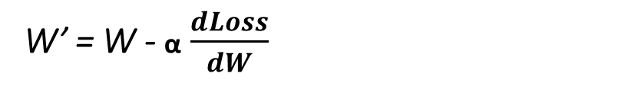
FFNN – Backward propagation
Backup
Gradient Descent
a
+
Loss
ŷ =
×
W
b
Loss = y - ŷ
W’ = W - α $\frac{dLoss}{dW}$
W
Gradient
W
W*
Updated Weights
Learning Rate

Slide 29
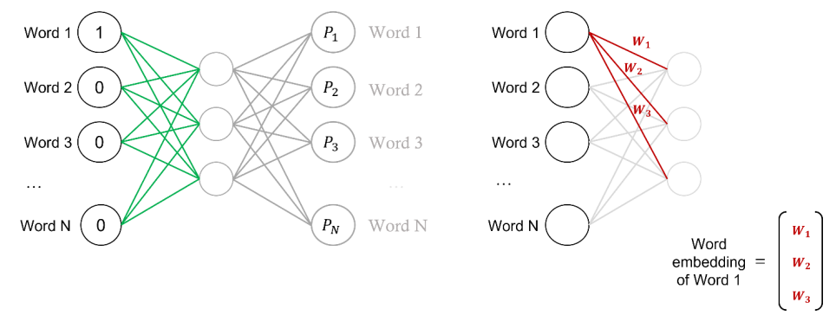
Word2Vec
Backup

Slide 30
Recurrent Neural Networks (memorizing the past)
Backup
Sentence = < >
1
2
3
O1 = f ( ×W + b)
O2 = f ( ×W + O1×W’ + b)
O3 = f ( ×W + O2×W’ + b)
ŷ = f (O3×W’’ + b)
1
Step 1
Step 2
Step 3
2
O1×W’
O2×W’
O3×W’’
f
ŷ
3
W
W
W
Loss = y - ŷ
1
2
3
The Loss becomes a function of many nested functions

Slide 31
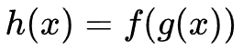
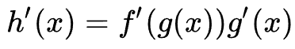
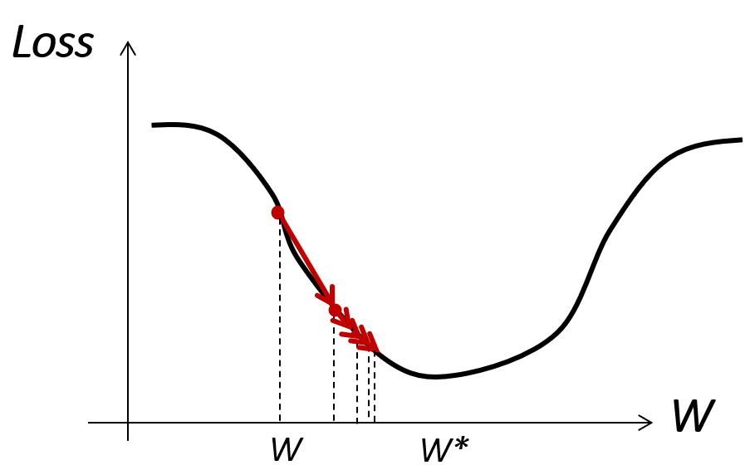
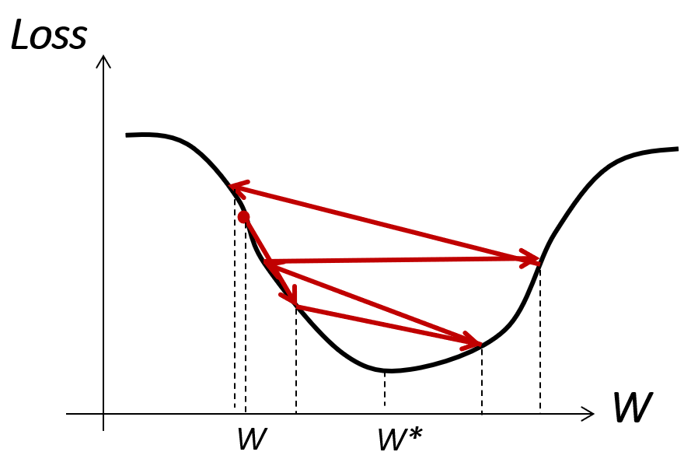
Chain Rule and gradient issues
Backup
Chain Rule
Every time we have a nested function we have to compute a multiplication of derivatives. Many nested functions, many multiplications.
The problem? Depending on the activation function f we choose, its derivative can be:
Always small (<1) causing the gradient to vanish
Always big (>>1) causing the gradient to explode

Slide 32
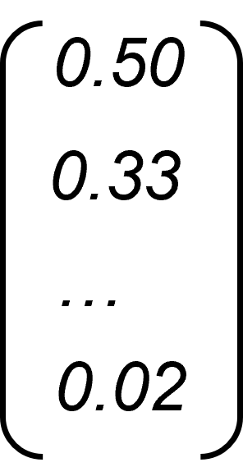
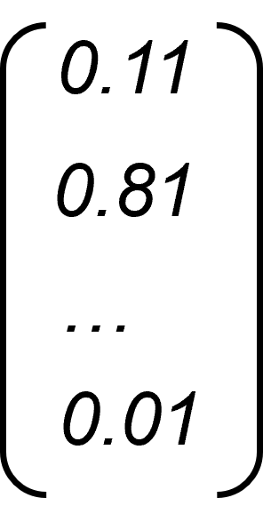
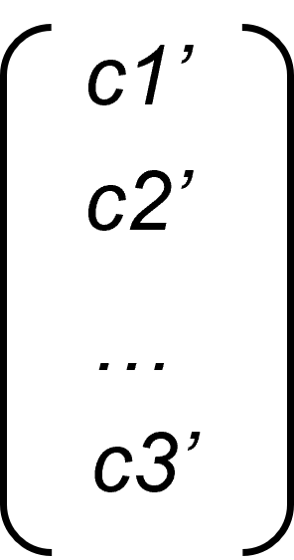
Long Short Term Memory Networks
Backup
Forget Gate
Input Gate
Output Gate
Ct-1
×
+
Ct
Ct
tanh
×
×
sigmoid
sigmoid
sigmoid
tanh
Ot
Ot-1
×
Ot-1×W
W
1

Slide 33
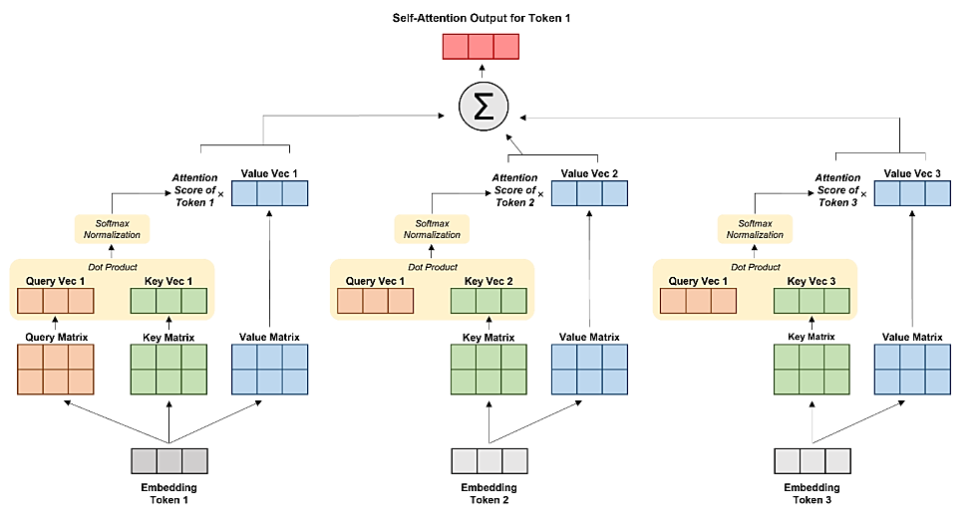
Attention mechanism
Backup

Slide 34
Attention mechanism
Backup

Slide 35
Attention mechanism
Backup

Slide 36
Attention mechanism
Backup

Slide 37
Attention mechanism
Backup

Slide 38
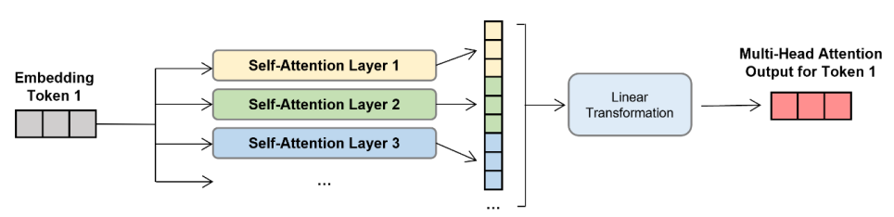
Multi-head attention mechanism
Backup

Slide 39

Transformer Encoder
Backup

